Slide 1
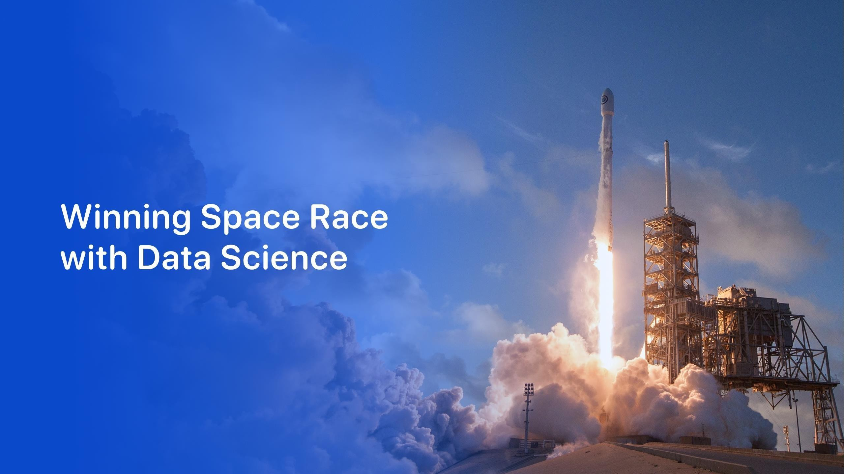

KOLLIPARA CHAITANYA ABHISHIKTH
25th March 2024

Slide 2
Outline
Executive Summary
Introduction
Methodology
Results
Conclusion
Appendix
2

Slide 3
Executive Summary
Summary of methodologies
Data Collection through API
Data Collection with Web Scraping
Data Wrangling
Exploratory Data Analysis with SQL
Exploratory Data Analysis with Data Visualization
Interactive Visual Analytics with Folium
Machine Learning Prediction
Summary of all results
Exploratory Data Analysis result
Interactive analytics in screenshots
Predictive Analytics result
3

Slide 4
Introduction
Project background and context
Space X advertises Falcon 9 rocket launches on its website with a cost of 62 million dollars; other providers cost upward of 165 million dollars each, much of the savings is because Space X can reuse the first stage. Therefore, if we can determine if the first stage will land, we can determine the cost of a launch. This information can be used if an alternate company wants to bid against space X for a rocket launch. This goal of the project is to create a machine learning pipeline to predict if the first stage will land successfully.
Problems you want to find answers
What factors determine if the rocket will land successfully?
The interaction amongst various features that determine the success rate of a successful landing.
What operating conditions needs to be in place to ensure a successful landing program.
4

Slide 5

5

Slide 6
Methodology
Executive Summary
Data collection methodology:
Data was collected using SpaceX API and web scraping from Wikipedia.
Perform data wrangling
One-hot encoding was applied to categorical features
Perform exploratory data analysis (EDA) using visualization and SQL
Perform interactive visual analytics using Folium and Plotly Dash
Perform predictive analysis using classification models
How to build, tune, evaluate classification models
6

Slide 7
Data Collection
The data was collected using various methods
Data collection was done using get request to the SpaceX API.
Next, we decoded the response content as a Json using .json() function call and turn it into a pandas dataframe using .json_normalize().
We then cleaned the data, checked for missing values and fill in missing values where necessary.
In addition, we performed web scraping from Wikipedia for Falcon 9 launch records with BeautifulSoup.
The objective was to extract the launch records as HTML table, parse the table and convert it to a pandas dataframe for future analysis.
7

Slide 8
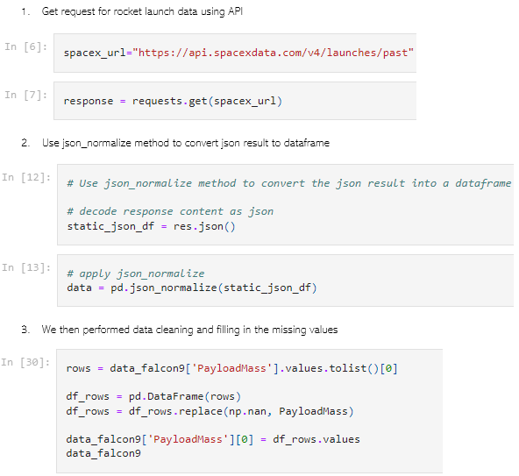
Data Collection – SpaceX API
We used the get request to the SpaceX API to collect data, clean the requested data and did some basic data wrangling and formatting.
The link to the notebook is https://github.com/ChaitanyaAbhishikth03/Data-Science-and-Machine-Learning-Capstone-Project/blob/main/Data%20Wrangling.ipynb.
8

Slide 9
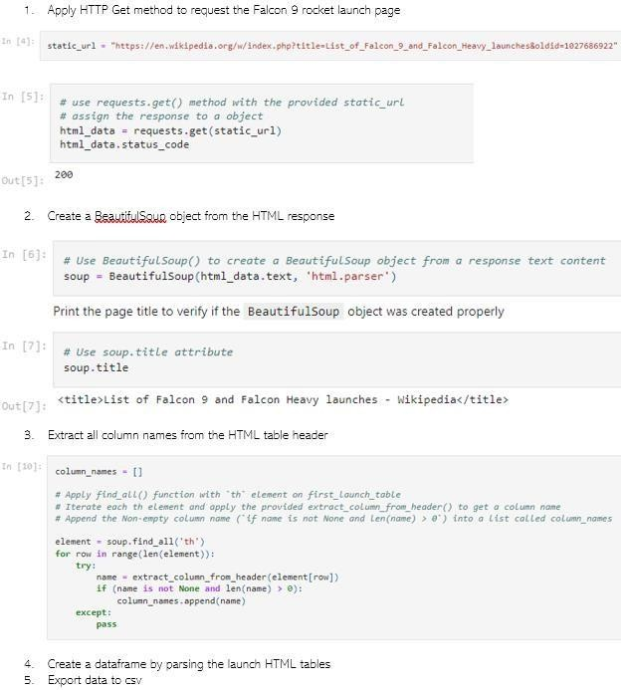
Data Collection - Scraping
We applied web scrapping to webscrap Falcon 9 launch records with BeautifulSoup
We parsed the table and converted
it into a pandas dataframe.
The link to the notebook is https://github.com/ChaitanyaAbhishikth03/Data-Science-and-Machine-Learning-Capstone-Project/blob/main/Data%20Collection%20with%20Web%20Scraping.ipynb.
9

Slide 10
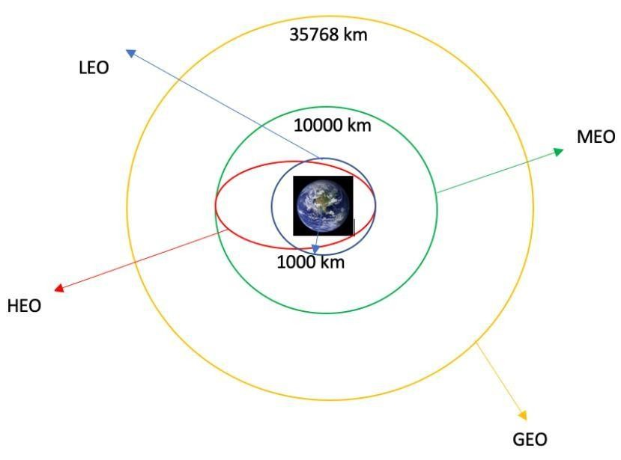
Data Wrangling
We performed exploratory data analysis
and determined the training labels.
We calculated the number of launches at each site, and the number and occurrence of each orbits
We created landing outcome label from outcome column and exported the results to csv.
The link to the notebook is https://github.com/ChaitanyaAbhishikth03/Data-Science-and-Machine-Learning-Capstone-Project/blob/main/EDA%20with%20Data%20Visualization.ipynb.
10

Slide 11
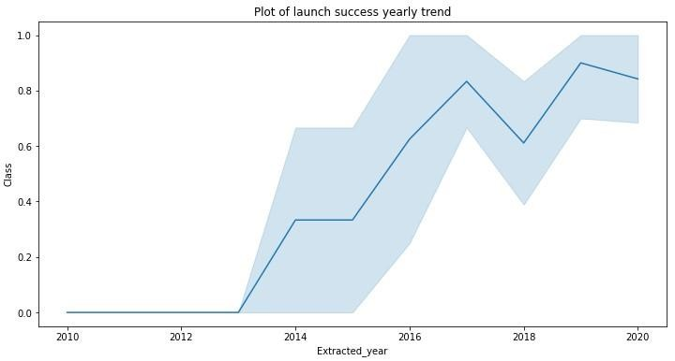
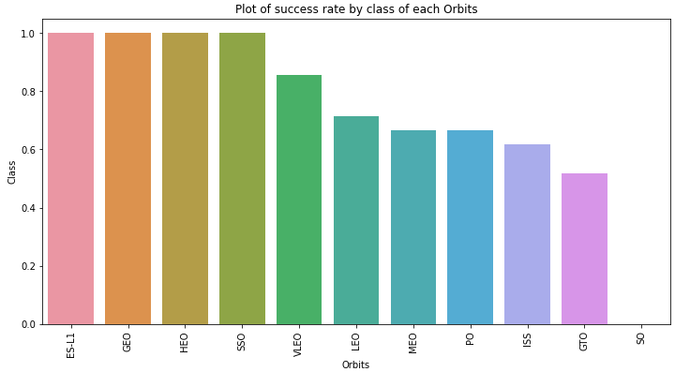
EDA with Data Visualization
We explored the data by visualizing the relationship between flight number and launch Site, payload and launch site, success rate of each orbit type, flight number and orbit type, the launch success yearly trend.
The link to the notebook is https://github.com/ChaitanyaAbhishikth03/Data-Science-and-Machine-Learning-Capstone-Project/blob/main/Extracting%20and%20Visualizing%20Stock%20Data.ipynb
11

Slide 12
EDA with SQL
We loaded the SpaceX dataset into a PostgreSQL database without leaving
the jupyter notebook.
We applied EDA with SQL to get insight from the data. We wrote queries to find out for instance:
The names of unique launch sites in the space mission.
The total payload mass carried by boosters launched by NASA (CRS)
The average payload mass carried by booster version F9 v1.1
The total number of successful and failure mission outcomes
The failed landing outcomes in drone ship, their booster version and launch site names.
The link to the notebook is https://github.com/ChaitanyaAbhishikth03/Data-Science-and-Machine-Learning-Capstone-Project/blob/main/EDA%20with%20SQL.ipynb

Slide 13
Build an Interactive Map with Folium
We marked all launch sites, and added map objects such as markers, circles, lines to mark the success or failure of launches for each site on the folium map.
We assigned the feature launch outcomes (failure or success) to class 0 and 1.i.e., 0 for failure, and 1 for success.
Using the color-labeled marker clusters, we identified which launch sites have
relatively high success rate.
We calculated the distances between a launch site to its proximities. We answered some question for instance:
Are launch sites near railways, highways and coastlines.
Do launch sites keep certain distance away from cities.

Slide 14
Build a Dashboard with Plotly Dash
We built an interactive dashboard with Plotly dash
We plotted pie charts showing the total launches by a certain sites
We plotted scatter graph showing the relationship with Outcome and Payload Mass (Kg) for the different booster version.
The link to the notebook is https://github.com/ChaitanyaAbhishikth03/Data-Science-and-Machine-Learning-Capstone-Project/blob/main/Interactive%20Visual%20Analytics%20with%20Folium.ipynb

Slide 15
Predictive Analysis (Classification)
We loaded the data using numpy and pandas, transformed the data, split our data into training and testing.
We built different machine learning models and tune different
hyperparameters using GridSearchCV.
We used accuracy as the metric for our model, improved the model using feature engineering and algorithm tuning.
We found the best performing classification model.
The link to the notebook is https://github.com/ChaitanyaAbhishikth03/Data-Science-and-Machine-Learning-Capstone-Project/blob/main/Machine%20Learning%20Prediction.ipynb

Slide 16
Results
Exploratory data analysis results
Interactive analytics demo in screenshots
Predictive analysis results

Slide 17


Slide 18
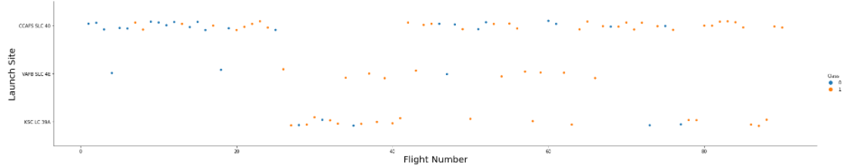
Flight Number vs. Launch Site
From the plot, we found that the larger the flight amount at a launch site, the greater the success rate at a launch site.
18

Slide 19

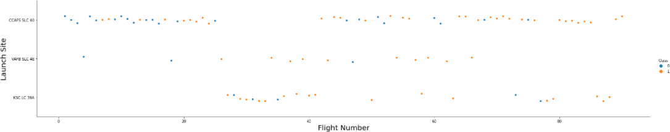
Payload vs. Launch Site
19

Slide 20

Success Rate vs. Orbit Type
From the plot, we can see that ES-L1, GEO, HEO, SSO, VLEO had the most success rate.
20

Slide 21
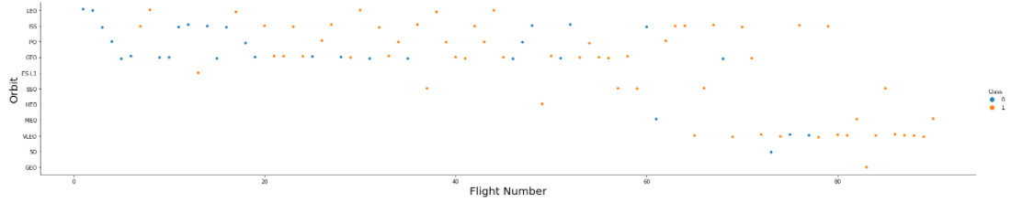
Flight Number vs. Orbit Type
The plot below shows the Flight Number vs. Orbit type. We observe that in the LEO orbit, success is related to the number of flights whereas in the GTO orbit, there is no relationship between flight number and the orbit.

Slide 22
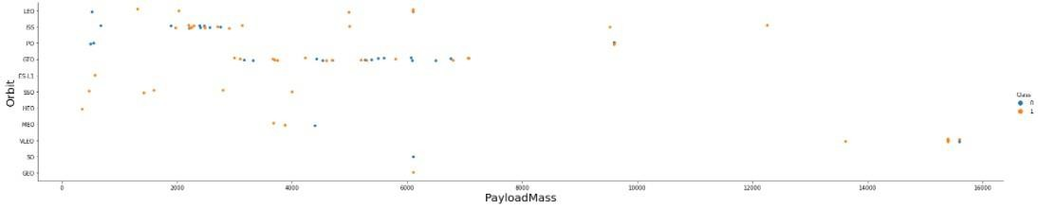
Payload vs. Orbit Type
We can observe that with heavy payloads, the successful landing are more for PO, LEO and ISS orbits.

Slide 23

Launch Success Yearly Trend
From the plot, we can observe that success rate since 2013 kept on increasing till 2020.
23

Slide 24
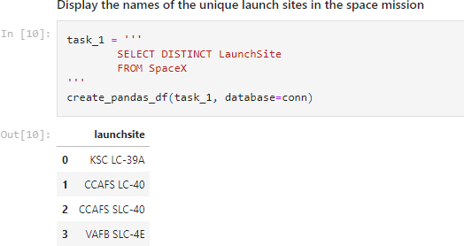
All Launch Site Names
We used the key word DISTINCT to show only unique launch sites from the SpaceX data.
24

Slide 25
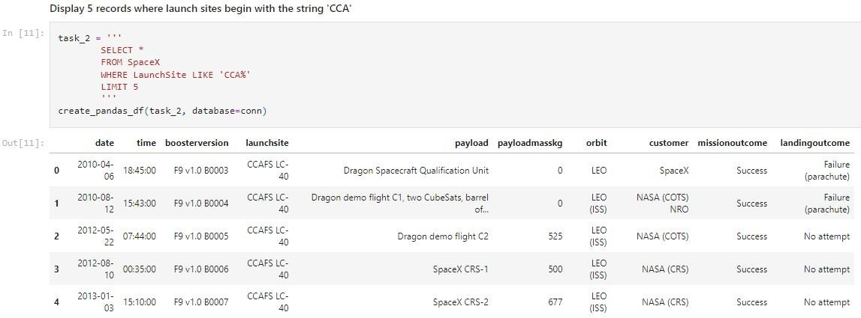
Launch Site Names Begin with 'CCA'
We used the query above to display 5 records where launch sites begin with
`CCA`

Slide 26
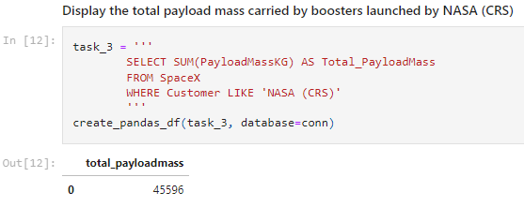
Total Payload Mass
We calculated the total payload carried by boosters from NASA as 45596 using the query below

Slide 27

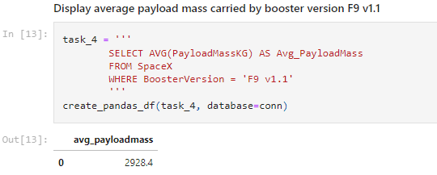
Average Payload Mass by F9 v1.1
We calculated the average payload mass carried by booster version F9 v1.1 as 2928.4
27

Slide 28
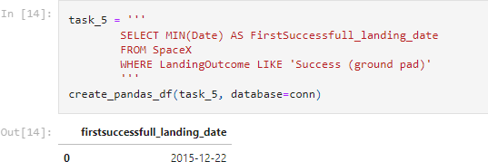
First Successful Ground Landing Date
We observed that the dates of the first successful landing outcome on ground pad was 22nd December 2015
28

Slide 29
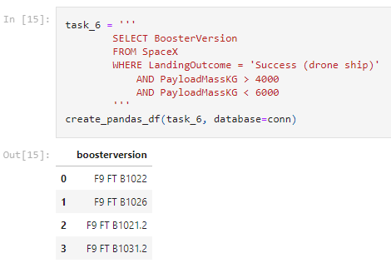
Successful Drone Ship Landing with Payload between 4000 and 6000
We used the WHERE clause to filter for boosters which have successfully landed on drone ship and applied the AND condition to determine successful landing with payload mass greater than 4000 but less than 6000
29

Slide 30
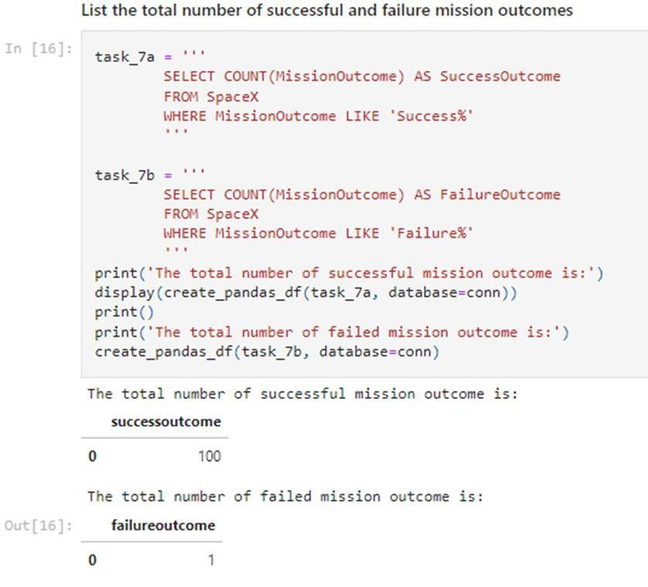
Total Number of Successful and Failure Mission Outcomes
We used wildcard like ‘%’ to filter for WHERE MissionOutcome was a success or a failure.
30

Slide 31
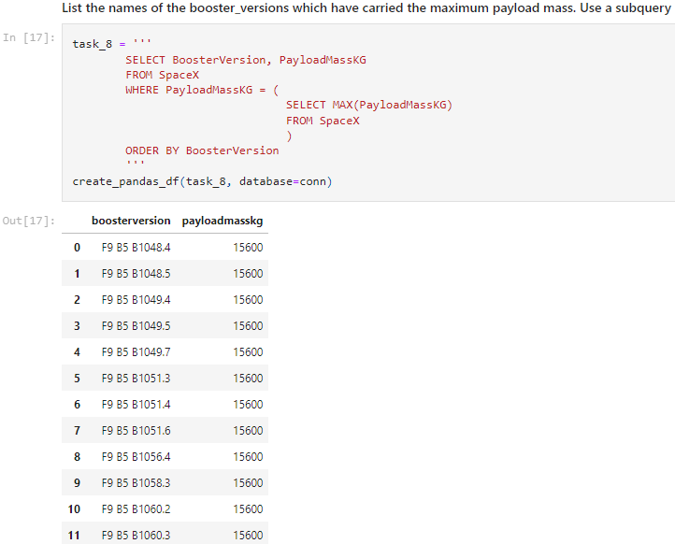
Boosters Carried Maximum Payload
We determined the booster that have carried the maximum payload using a subquery in the WHEREclause and the MAX() function.
31

Slide 32
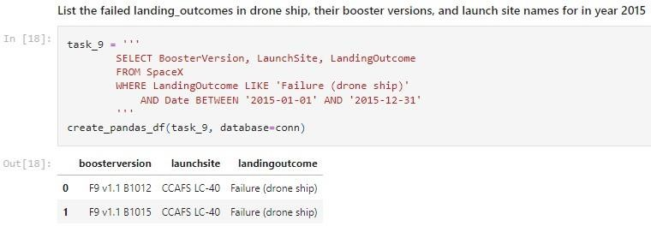
2015 Launch Records
We used a combinations of the WHERE clause, LIKE, AND, and BETWEEN conditions to filter for failed landing outcomes in drone ship, their booster versions, and launch site names for year 2015
32

Slide 33
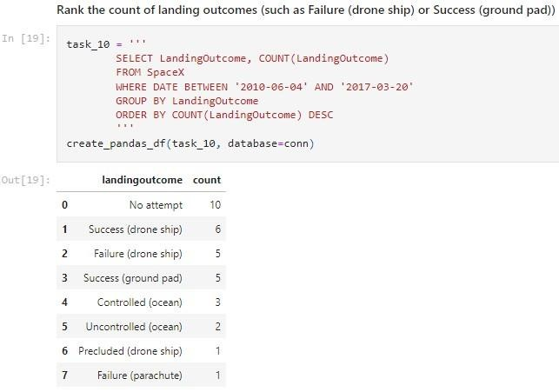
Rank Landing Outcomes Between 2010-06-04 and 2017-03-20
We selected Landing outcomes and the COUNT of landing outcomes from the data and used the WHERE clause to filter for landing outcomes BETWEEN 2010-06-04 to 2010-03-20.
We applied the GROUP BYclause to group the landing outcomes and the ORDERBYclause to order the grouped landing outcome in descending order.
33

Slide 34


Slide 35
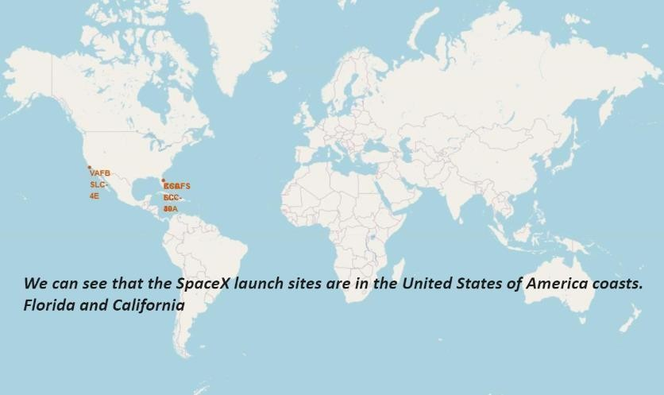
All launch sites global map markers

Slide 36
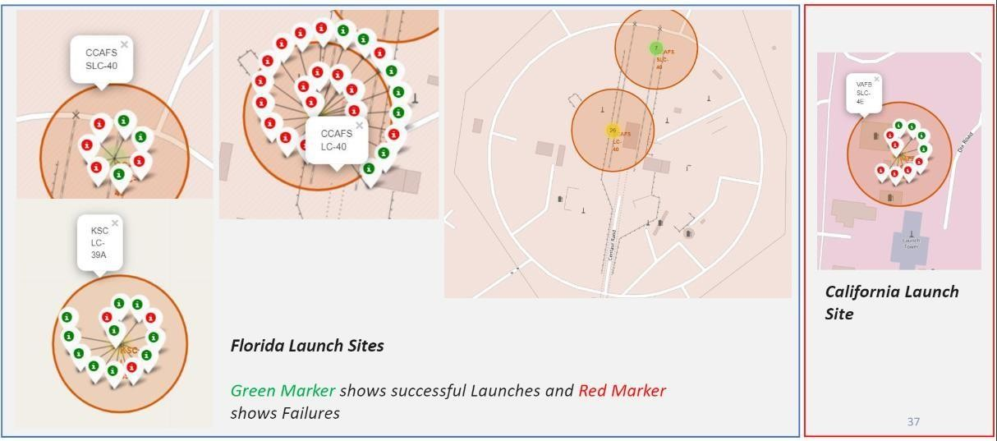
Markers showing launch sites with color labels

Slide 37
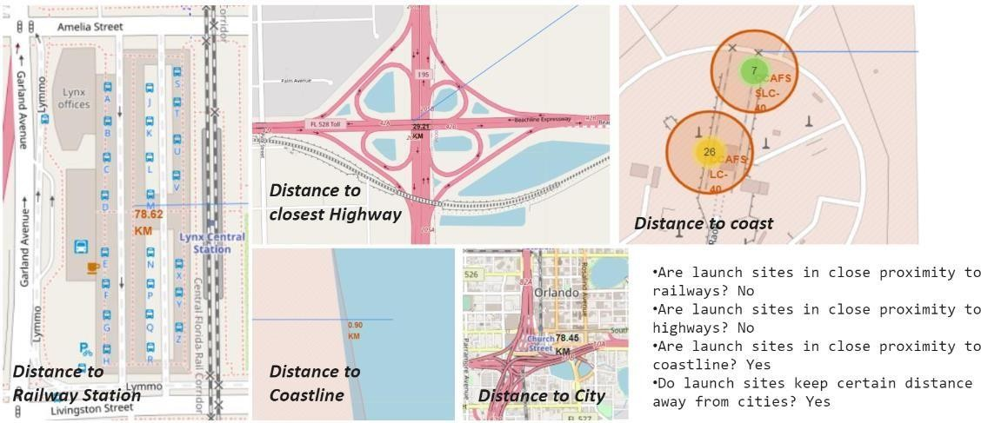
Launch Site distance to landmarks

Slide 38


Slide 39
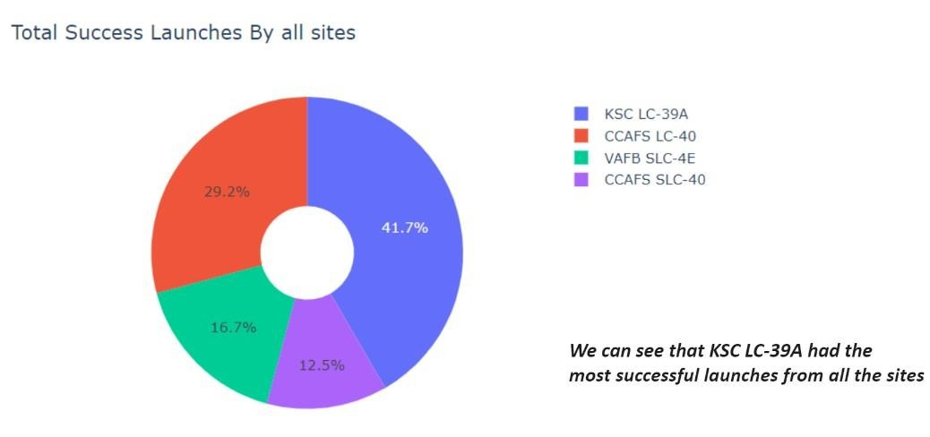
Pie chart showing the success percentage achieved by each launch site
39

Slide 40
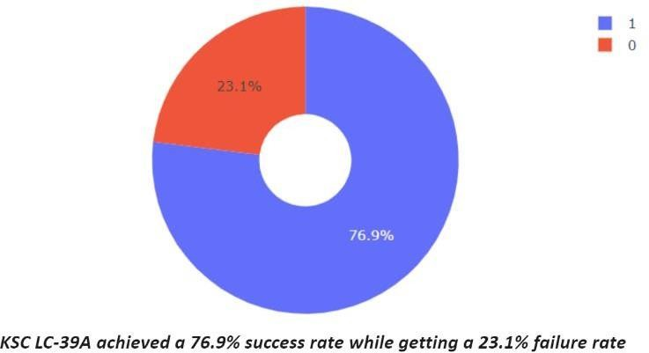
Pie chart showing the Launch site with the highest launch success ratio
40

Slide 41
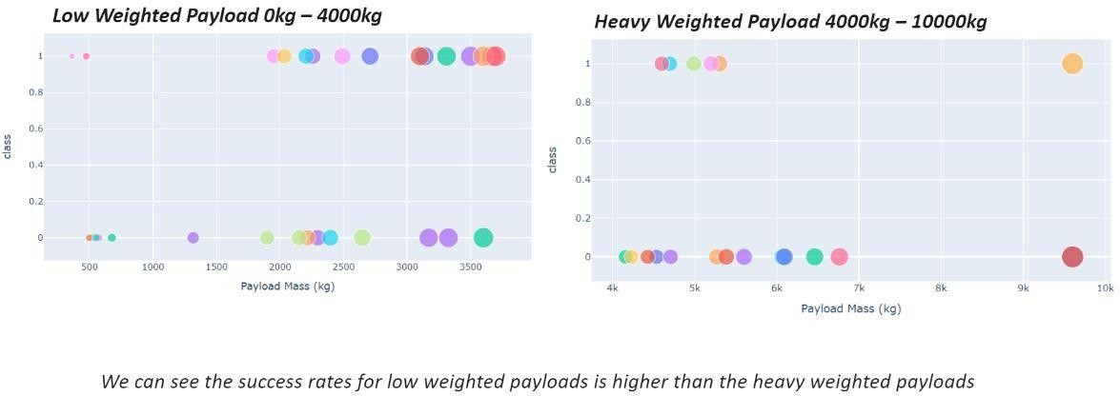
Scatter plot of Payload vs Launch Outcome for all sites, with different
payload selected in the range slider
41

Slide 42


Slide 43

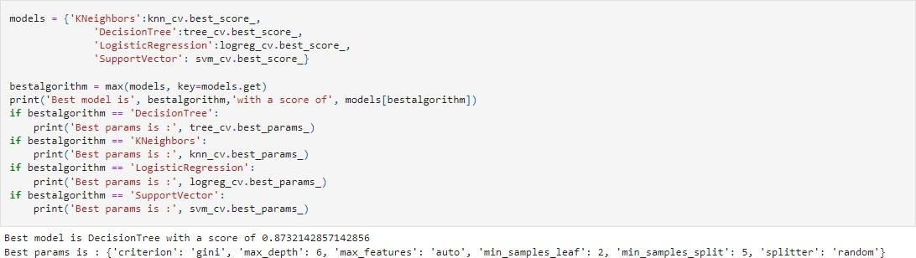
Classification Accuracy
The decision tree classifier is the model with
the highest classification accuracy
43

Slide 44
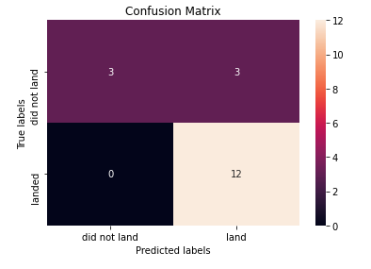
Confusion Matrix
The confusion matrix for the decision tree classifier shows that the classifier can distinguish between the different classes. The major problem is the false positives .i.e., unsuccessful landing marked as successful landing by the classifier.

Slide 45
Conclusions
We can conclude that:
The larger the flight amount at a launch site, the greater the success rate at a launch site.
Launch success rate started to increase in 2013 till 2020.
Orbits ES-L1, GEO, HEO, SSO, VLEO had the most success rate.
KSC LC-39A had the most successful launches of any sites.
The Decision tree classifier is the best machine learning algorithm for this task.

Slide 46
